Slide 1

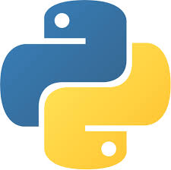
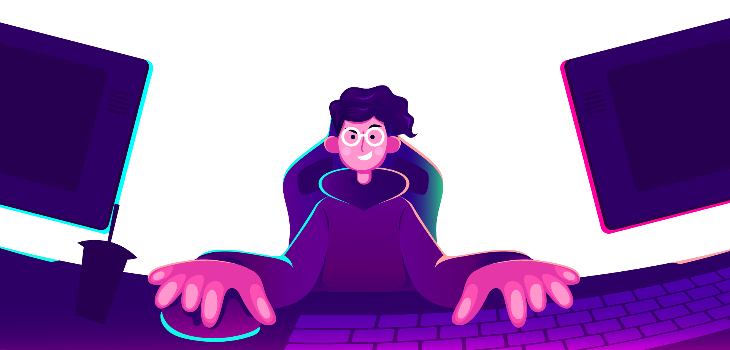
AI Master Class series – Day 2
How to install Python & Libraries | Basic programming

Slide 2
Prerequisites for this Course
Laptop with Good Internet
No basic knowledge is required.

Slide 3
Day-2 Agenda.
01.
02.
03.
Programming languages for AI
Python IDE & Installing Python
Setting Environment & Installing libraries from Command window
04.
05.
Basic Python Programming
Q & A Session
Overview on Language
How to run Python Script
Python in Command prompt
Basic syntax of Python

Slide 4

Programming Languages for AI.
Python
C++
Matlab
Java
LISP
Prolog
Julia
Haskell
“In a way, AI is both closer and farther off than we imagine. AI is closer to being able to do more powerful things than most people expect — driving cars, curing diseases, discovering planets, understanding media. Those will each have a great impact on the world, but we're still figuring out what real intelligence is.” – Mark Zuckerberg

Slide 5
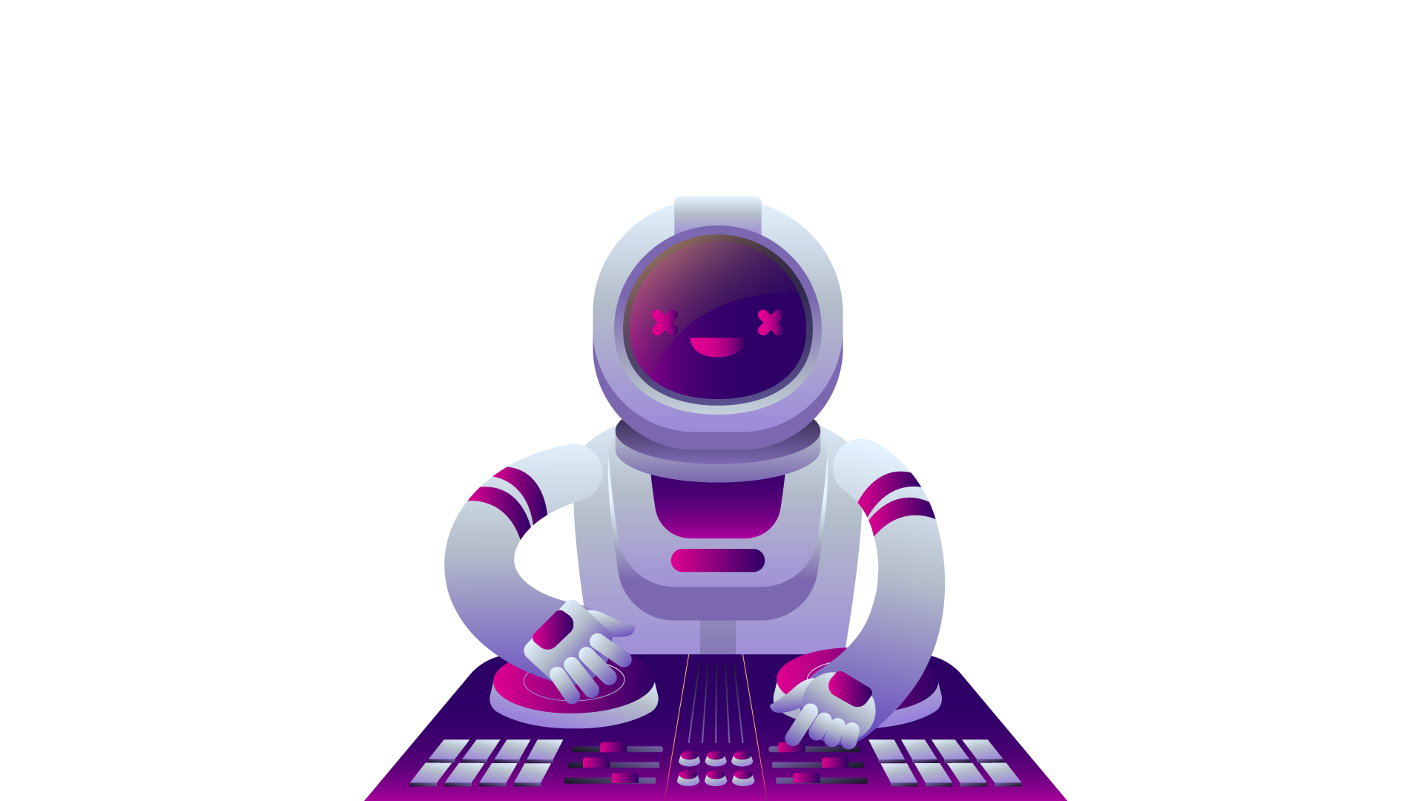
Python & Uses.
Python is a popular programming language. It was created by Guido van Rossum, and released in 1991.
Python is a programming language that lets you work more quickly and integrate your systems more effectively.
Web development
Handle Big data
Handles complex Mathematics
Software development
Connects to database systems

Slide 6
Why Python?.
Python works on Windows, Linux, Mac, Raspberry Pi, NVidia boards (linux), PYNQ FPGA etc.
Few lines of Programming
Prototyping of Python programming is fast
Syntax is same as like normal English language
It relies on Indentation, whitespace, scope of loops, functions and classes
Latest version of python is version3 (3.9).

Slide 7
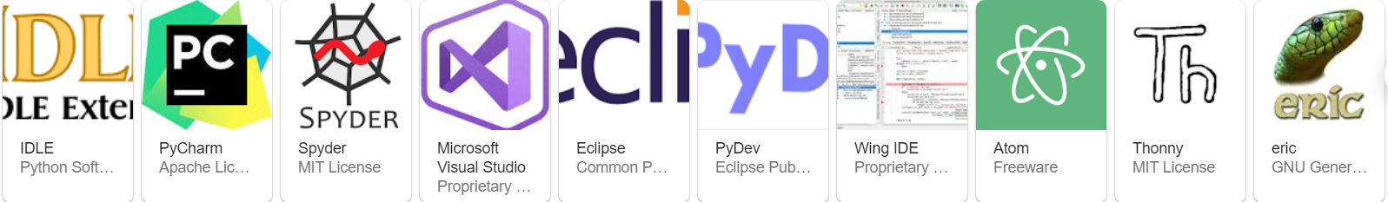
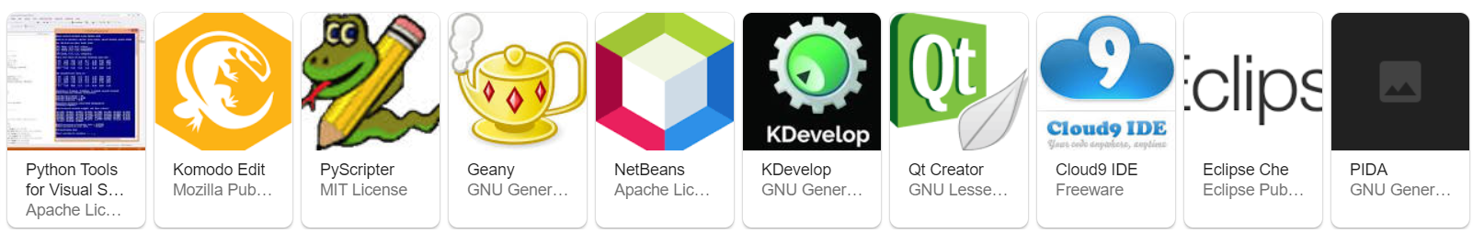
Python IDE.
IDLE : Python Software foundation license
PYCHARM: Apache license
SPYDER: MIT license

Slide 8

Practical session

Slide 9
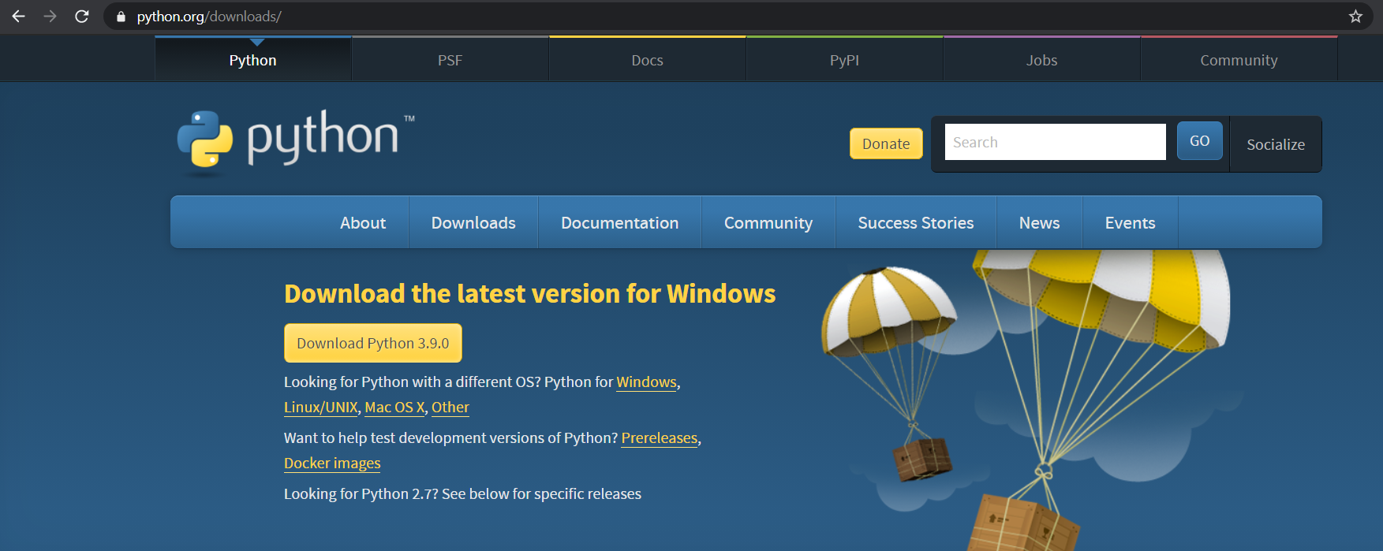
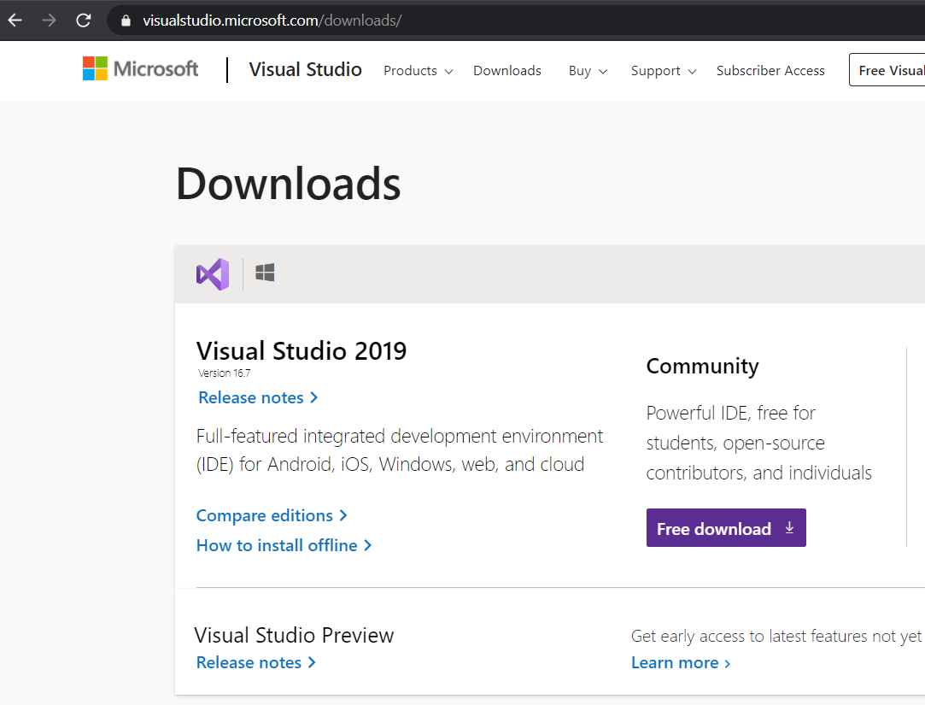
Installing Python IDLE
PYTHON.ORG | MICROSOFT VISUAL STUDIO

Slide 10
Setting Python in Environment Varaibles to access from Command window

Slide 11
Installing Python Libraries

Slide 12
Basic Python Programming
print(‘Hello world’)

Slide 13
Add two number.
a = 5.4
b = 4.6
sum = float(a) + float(b)
print(sum)
User Input.
a = input(“Enter number1: “)
b = input(“Enter number2: “)
sum = int(a) + int(b)
print(“The sum of {0} and {1} is {2}”.format(a, b, sum))

Slide 14
If & Elif.
a = 33
b = 33
if a > b:
print(“a is greater than b")
elif a == b:
print("a and b are same")
else:
print("b is greater than a")
AND | OR.
a = 200
b = 33
c = 500
if a > b and c > a:
print("Both conditions are True")
#if a > b or c > a:
# print(“only one is True")

Slide 15
While.
i = 1
while i < 20:
print(i)
i += 1
FOR.
for x in range(10):
print(x)
for x in range(1, 10):
print(x)
for x in range(1, 10, 2):
print(x)

Slide 16
Fuction.
def funName():
print("Hello from a function")
funName()
File Handling.
a = open(‘pantech.txt’, ‘r’)
print(a.read())
a.close()

Slide 17
Q & A session

Slide 18
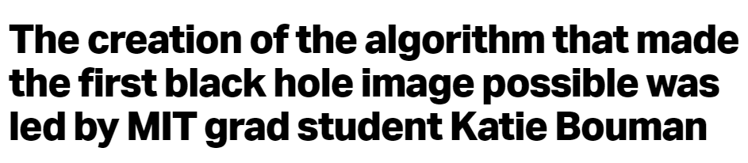
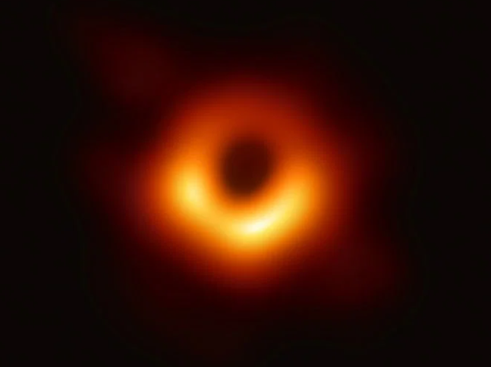
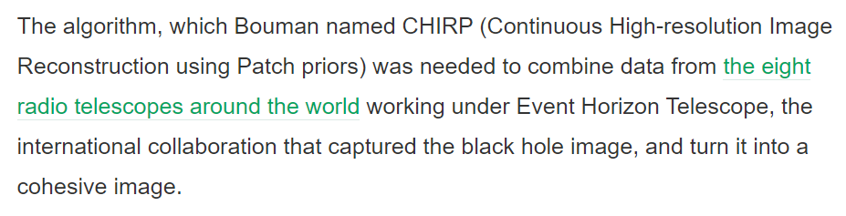
AI News – Day 2. 2017

Slide 19
Thanks!
Tomorrow session
Do you have any questions?
sanjay@pantechmail.com
www.pantechsolutions.net
Introduction to Computer Vision
Install Computer vision Libraries

